Slide 1

RESTAURANT MANAGEMENT SYSTEM
Team members
25B11CS525: AKHIL SANTOSH
25B11CS397: VENKATESH
25B11CS320:LALITHAPRASAD
25B11CSA62: PUNEETH KUMAR

Slide 2
Real-World Problem
Restaurants need to manage many customers, employees, dining tables, menu items, orders, bills, and payments.
Managing these details manually can lead to:
Errors in customer and order records
Difficulty in tracking table availability
Mistakes while recording orders
Problems in calculating bills
Difficulty in tracking payments
More time spent searching for information
Our Restaurant Management System solves these problems by storing and managing restaurant information in a database.

Slide 3
Why the Project is Needed
The project is needed to make restaurant activities faster, easier, and more organized.
It helps staff:
Quickly manage customer information
Check dining table availability
Manage menu items and prices
Record and track customer orders
Manage bills and discounts
Record payment information
It reduces manual paperwork and helps avoid common errors in order, billing, and payment management.

Slide 4
Objectives of the Project
To maintain customer details in a database.
To maintain employee details and their roles.
To manage dining table information and availability.
To maintain menu items, categories, prices, and availability.
To record and manage customer orders.
To maintain order items and quantities.
To generate and manage bills.
To store and manage payment information.
To reduce manual work and data entry errors.
To provide quick and accurate access to restaurant records.

Slide 5
Functional Requirements
Functional Requirements are the tasks the system should perform:
Register and manage customer details.
Add, update, and delete employee information.
Manage dining table details.
Check dining table availability.
Add and manage menu items.
Check menu item availability.
Create and manage customer orders.
Record ordered items and quantities.
Generate bills and apply discounts.
Record payment details.
Generate customer, order, billing, and payment records.

Slide 6
Non-Functional Requirements
Non-Functional Requirements describe how the system should work:
Security: Customer and payment information should be protected.
Reliability: The system should provide accurate and consistent information.
Performance: The system should respond quickly to user requests.
Usability: The system should be simple and easy to use.
Scalability: The database should support more customers, employees, tables, menu items, and orders as the restaurant grows.
Data Integrity: The database should maintain correct and consistent records using primary keys, foreign keys, and constraints.

Slide 7
End Users of the System
Restaurant Manager:
Manage employees and restaurant operations.
View customer, order, billing, and payment information.
Cashier:
Manage bills and payments.
View order and customer details.
Waiters:
Manage customer orders.
Record ordered menu items.
Assist customers with table and order information.
Restaurant Staff:
Manage dining table status.
Assist with restaurant operations.
Customers:
Provide personal information.
Place orders.
Select menu items.
Administrator:
Manage database records.
Maintain restaurant information and overall system operations.

Slide 8
Entities and Attributes
Customer:
Stores information about customers who visit the restaurant.
Attributes:
Customer_ID — Primary Key
Name
Phone
Email
Address
Why included?
We need customer details to identify each customer and maintain their contact information and address.

Slide 9
Employee:
Stores information about employees working in the restaurant.
Attributes:
Employee_ID — Primary Key
Name
Phone
Email
Role
Why included?
We need employee details to identify restaurant employees and maintain their contact information and roles.

Slide 10
Dining Table:
Stores information about the dining tables available in the restaurant.
Attributes:
Table_ID — Primary Key
Capacity
Status
Why included?
The restaurant needs to know the available tables, their seating capacity, and whether they are currently available or occupied.

Slide 11
Menu:
Stores information about food and beverage items available in the restaurant.
Attributes:
Item_ID — Primary Key
Item_Name
Category
Price
Availability
Why included?
We need menu details to maintain the food items, their categories, prices, and availability.

Slide 12
Orders:
Stores information about customer orders placed in the restaurant.
Attributes:
Order_ID — Primary Key
Customer_ID — Foreign Key
Employee_ID — Foreign Key
Table_ID — Foreign Key
Order_Date
Order_Time
Order_Status
Why included?
We need order details to identify each order, the customer who placed it, the employee handling it, the dining table used, and the current order status.

Slide 13
Order Item:
Stores information about the menu items included in each order.
Attributes:
Order_ID — Primary Key / Foreign Key
Item_ID — Primary Key / Foreign Key
Quantity
Unit_Price
Why included?
An order can contain different menu items, so the Order Item entity records which items were ordered, their quantities, and their prices.
The combination of Order_ID and Item_ID acts as the composite primary key.

Slide 14
Bill:
Stores information about bills generated for customer orders.
Attributes:
Bill_ID — Primary Key
Order_ID — Foreign Key
Bill_Date
Total_Amount
Discount
Why included?
We need bill details to calculate and maintain the total amount and discount associated with each order.

Slide 15
Payment:
Stores information about payments made for restaurant bills.
Attributes:
Payment_ID — Primary Key
Bill_ID — Foreign Key
Payment_Date
Amount
Status
Payment_Type
Why included?
We need payment details to record the amount paid, payment date, payment status, and payment method such as cash, card, or UPI.

Slide 16
Relationships
Dining Table — Orders
Relationship: Used_for
Cardinality: 1:M
One dining table can be associated with many orders over time, but each order is associated with one dining table.
Example:
Table 2 can be associated with Order 501 and other orders at different times.
Orders — Order Item
Relationship: Contains
Cardinality: 1:M
One order can contain many order items, but each order item belongs to one order.
Example:
Order 501 can contain multiple menu items.

Slide 17
Menu — Order Item
Relationship: Included_in
Cardinality: 1:M
One menu item can appear in many order items, but each order item refers to one menu item.
Example:
Chicken Biryani can be included in Order 501, Order 515, and other orders.
Orders — Bill
Relationship: Generates
Cardinality: 1:1
One order generates one bill, and each bill belongs to one order.
Bill — Payment
Relationship: Has
Cardinality: 1:1
One bill has one payment record, and each payment belongs to one bill in our basic system.

Slide 18
Cardinalities
Customer–Orders: 1:M
One customer can place many orders, but each order belongs to one customer.
Employee–Orders: 1:M
One employee can handle many orders, but each order is handled by one employee.
Dining Table–Orders: 1:M
One dining table can be associated with many orders over different periods, but each order is associated with one table.
Orders–Order Item: 1:M
One order can contain many order items, but each order item belongs to one order.

Slide 19
Menu–Order Item: 1:M
One menu item can appear in many order items, but each order item refers to one menu item.
Orders–Bill: 1:1
One order generates one bill, and each bill belongs to one order.
Bill–Payment: 1:1
One bill has one payment record, and each payment belongs to one bill in our basic system.
M:N Relationship
Orders and Menu Items can have an M:N relationship because one order can contain multiple menu items and one menu item can be included in multiple orders.
This M:N relationship is handled through the Order_Item entity.

Slide 20
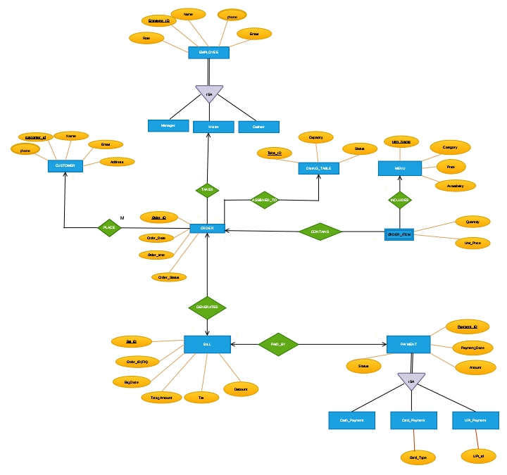

Slide 21
Relational Schema
CUSTOMER(
Customer_ID: INT PK,
Name: VARCHAR(50),
Phone: VARCHAR(15),
Email: VARCHAR(50),
Address: VARCHAR(100)
)
EMPLOYEE(
Employee_ID: INT PK,
Name: VARCHAR(50),
Phone: VARCHAR(15),
Email: VARCHAR(50),
Role: VARCHAR(30)
)
DINING_TABLE(
Table_ID: INT PK,
Capacity: INT,
Status: VARCHAR(20)
)

Slide 22
Relational Schema
MENU(
Item_ID: INT PK,
Item_Name: VARCHAR(50),
Category: VARCHAR(30),
Price: NUMBER(10,2),
Availability: VARCHAR(20)
)
ORDERS(
Order_ID: INT PK,
Customer_ID: INT FK,
Employee_ID: INT FK,
Table_ID: INT FK,
Order_Date: DATE,
Order_Time: VARCHAR(8),
Order_Status: VARCHAR(20)
)

Slide 23
Relational Schema
ORDER_ITEM(
Order_ID: INT PK, FK,
Item_ID: INT PK, FK,
Quantity: INT,
Unit_Price: NUMBER(10,2)
)
BILL(
Bill_ID: INT PK,
Order_ID: INT FK,
Bill_Date: DATE,
Total_Amount: NUMBER(10,2),
Discount: NUMBER(10,2)
)
PAYMENT(
Payment_ID: INT PK,
Bill_ID: INT FK,
Payment_Date: DATE,
Amount: NUMBER(10,2),
Status: VARCHAR(20),
Payment_Type: VARCHAR(20)
)

Slide 24
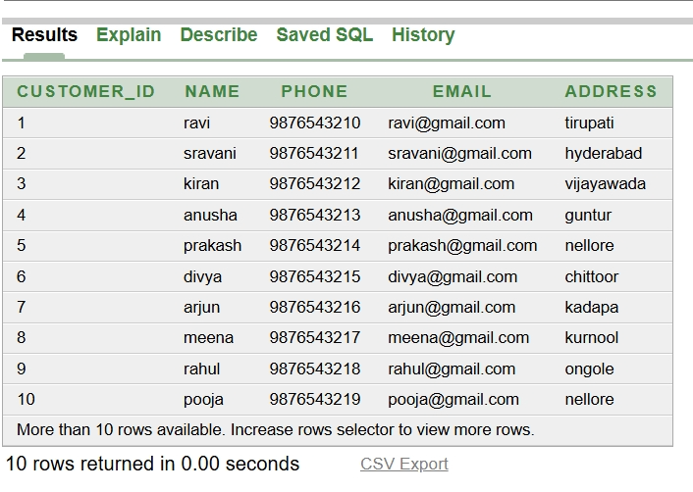
CUSTOMER TABLE:
CREATE TABLE customer (
customer_id INT PRIMARY KEY,
name VARCHAR2(50) NOT NULL,
phone VARCHAR2(15) UNIQUE NOT NULL,
email VARCHAR2(50) UNIQUE NOT NULL,
address VARCHAR2(100) NOT NULL
);

Slide 25
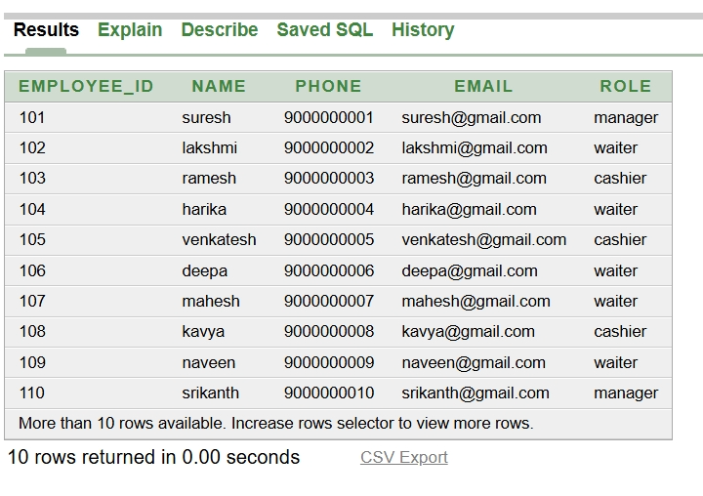
EMPLOYEE TABLE:
CREATE TABLE employee (
employee_id INT PRIMARY KEY,
name VARCHAR2(50) NOT NULL,
phone VARCHAR2(15) UNIQUE NOT NULL,
email VARCHAR2(50) UNIQUE NOT NULL,
role VARCHAR2(30) NOT NULL
);

Slide 26
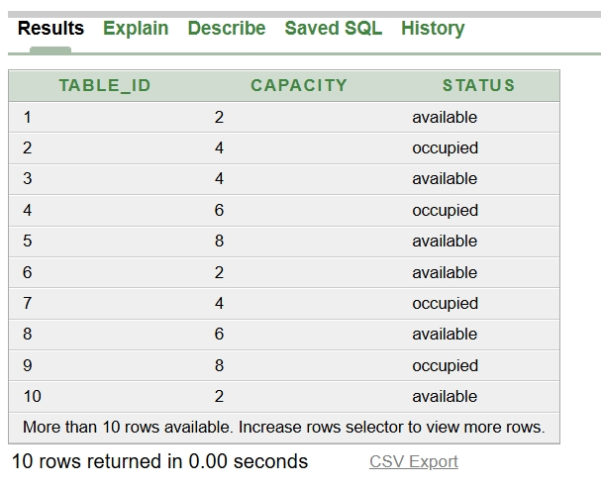
DINING_TABLE:
CREATE TABLE dining_table (
table_id INT PRIMARY KEY,
capacity INT NOT NULL,
status VARCHAR(20) NOT NULL
);

Slide 27
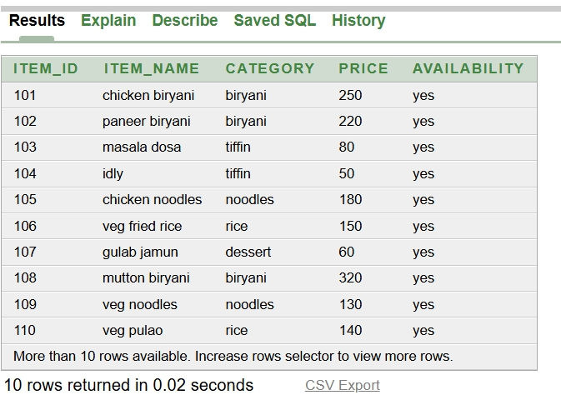
MENU TABLE:
CREATE TABLE menu (
item_id INT PRIMARY KEY,
item_name VARCHAR2(50) NOT NULL,
category VARCHAR2(30) NOT NULL,
price NUMBER(10,2) NOT NULL,
availability VARCHAR2(20) NOT NULL
);

Slide 28
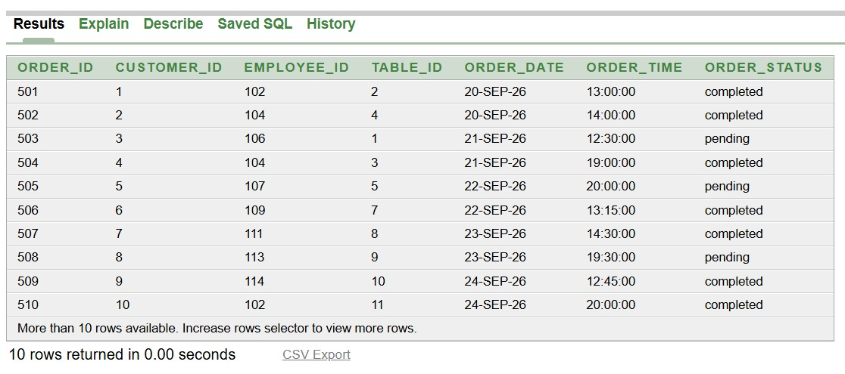
ORDERS TABLE:
CREATE TABLE orders (
order_id INT PRIMARY KEY,
customer_id INT NOT NULL,
employee_id INT NOT NULL,
table_id INT NOT NULL,
order_date DATE NOT NULL,
order_time VARCHAR2(8) NOT NULL,
order_status VARCHAR2(20) NOT NULL,
FOREIGN KEY (customer_id) REFERENCES customer(customer_id),
FOREIGN KEY (employee_id) REFERENCES employee(employee_id),
FOREIGN KEY (table_id) REFERENCES dining_table(table_id)
);

Slide 29
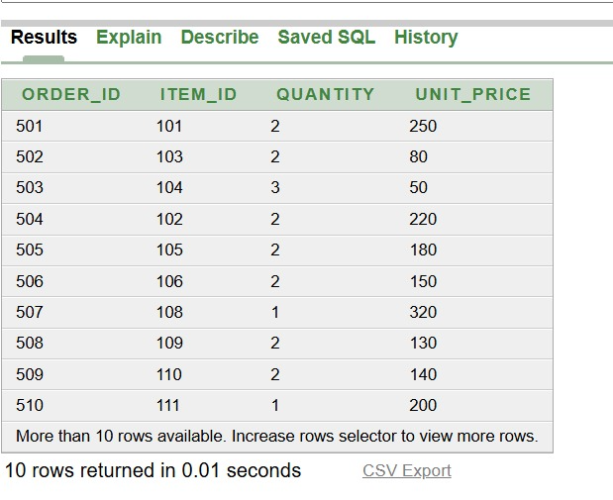
ORDER_ITEM TABLE:
CREATE TABLE order_item (
order_id INT,
item_id INT,
quantity INT NOT NULL,
unit_price NUMBER(10,2) NOT NULL,
PRIMARY KEY (order_id, item_id),
FOREIGN KEY (order_id) REFERENCES orders(order_id),
FOREIGN KEY (item_id) REFERENCES menu(item_id)
);

Slide 30
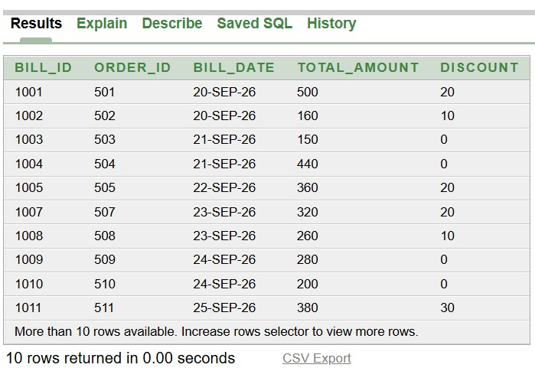
BILL TABLE:
CREATE TABLE bill (
bill_id INT PRIMARY KEY,
order_id INT UNIQUE NOT NULL,
bill_date DATE NOT NULL,
total_amount NUMBER(10,2) NOT NULL,
discount NUMBER(10,2) DEFAULT 0,
FOREIGN KEY (order_id) REFERENCES orders(order_id)
);

Slide 31
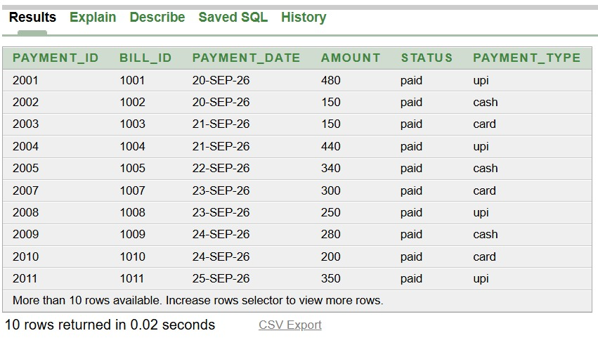
PAYMENT TABLE:
CREATE TABLE payment (
payment_id INT PRIMARY KEY,
bill_id INT UNIQUE NOT NULL,
payment_date DATE NOT NULL,
amount NUMBER(10,2) NOT NULL,
status VARCHAR2(20) NOT NULL,
payment_type VARCHAR2(20) NOT NULL,
FOREIGN KEY (bill_id) REFERENCES bill(bill_id)
);

Slide 32
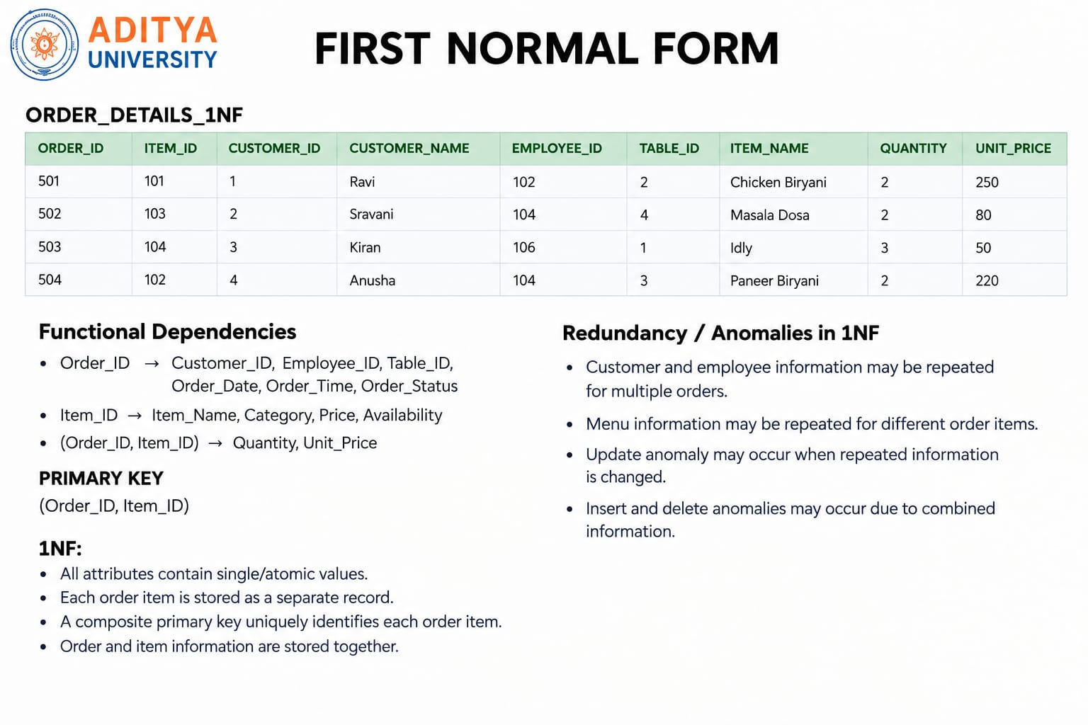

Slide 33
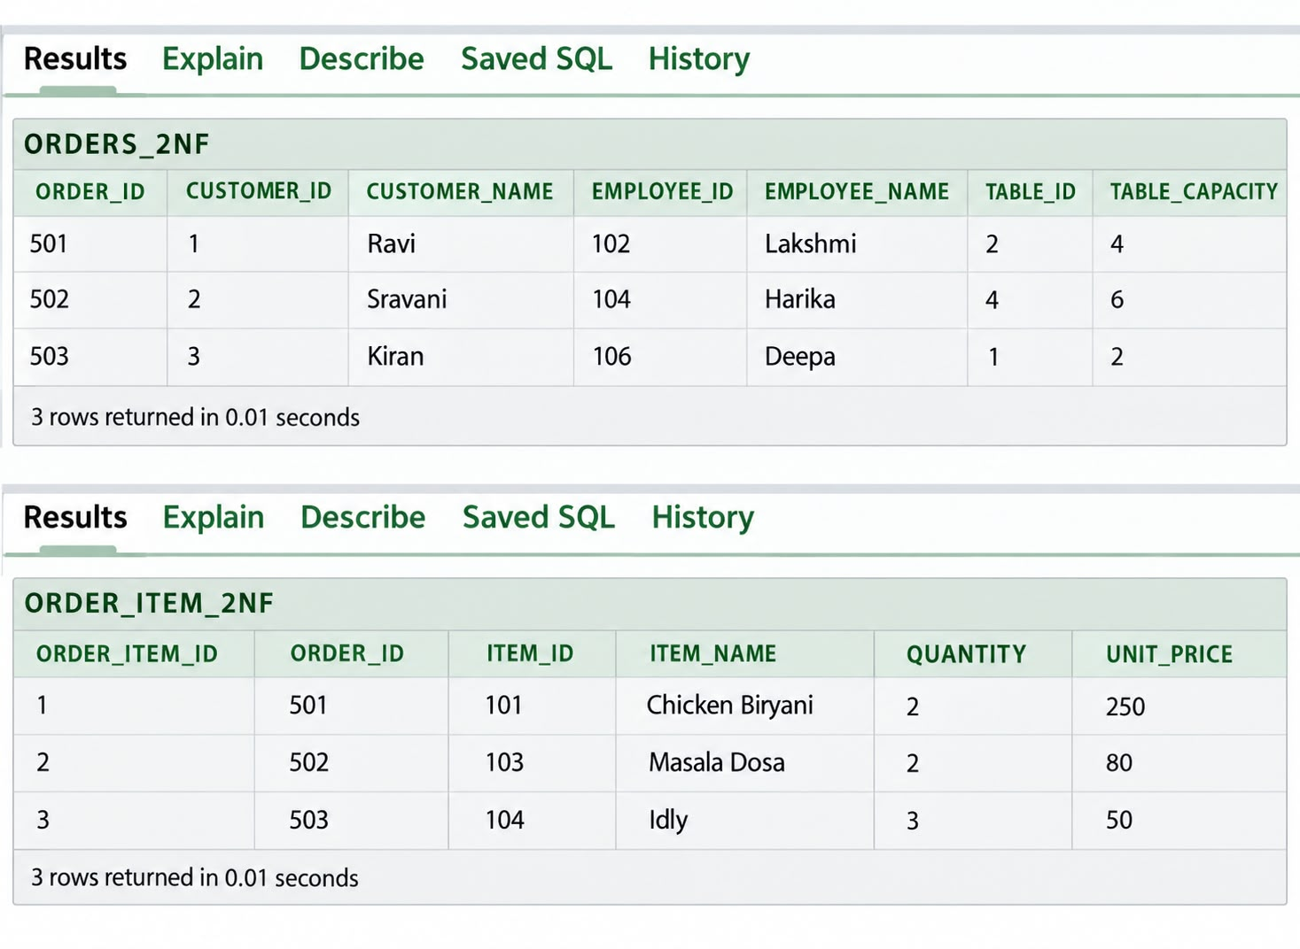
Second normal from
Functional Dependencies:
Order_ID → Customer_ID, Customer_Name, Employee_ID, Employee_Name, Table_ID, Table_Capacity
Order_Item_ID → Order_ID, Item_ID, Item_Name, Quantity, Unit_Price
PRIMARY KEYS
ORDERS_2NF: Order_ID
ORDER_ITEM_2NF: Order_Item_ID
2NF:
The 1NF relation is divided into two relations based on order and order-item information.
Each relation has a single-column primary key.
Order information is stored in ORDERS_2NF.
Item information related to each order is stored in ORDER_ITEM_2NF.
This reduces unnecessary repetition of order and item information.

Slide 34
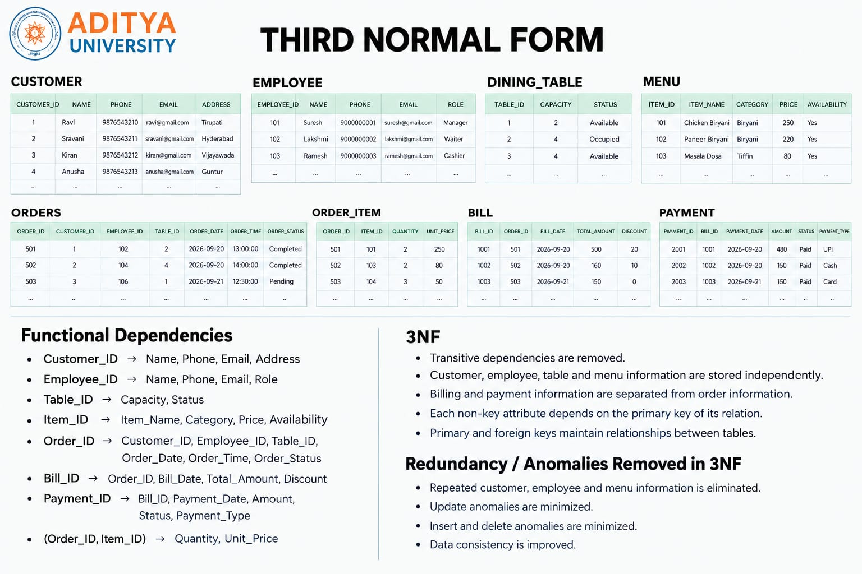

Slide 35
Conclusion
To conclude, our Restaurant Management System helps manage customers, employees, dining tables, menu items, orders, bills, and payments in an organized way.
It reduces manual work, improves data management, and provides quick access to accurate restaurant records.
Overall, the system helps make restaurant operations more organized, efficient, and reliable.

Slide 36
THANK YOU

